Slide 1

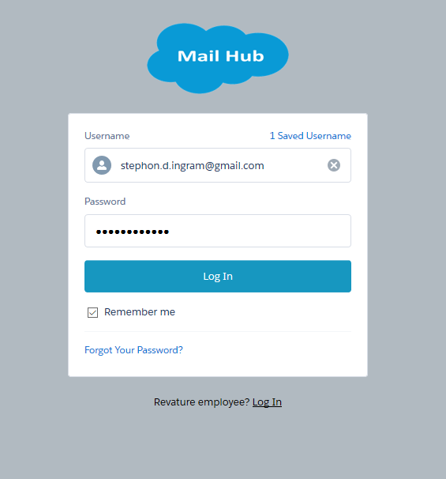
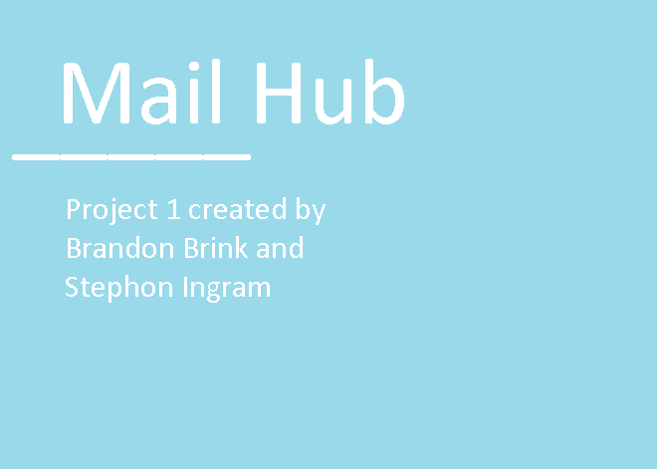
Mail Hub
Project 1 created by Stephon Ingram and Brandon Brink

Slide 2




Agenda
Intro to Community
Who is Jack
What can Jack do?
Demo of a Process

Slide 3
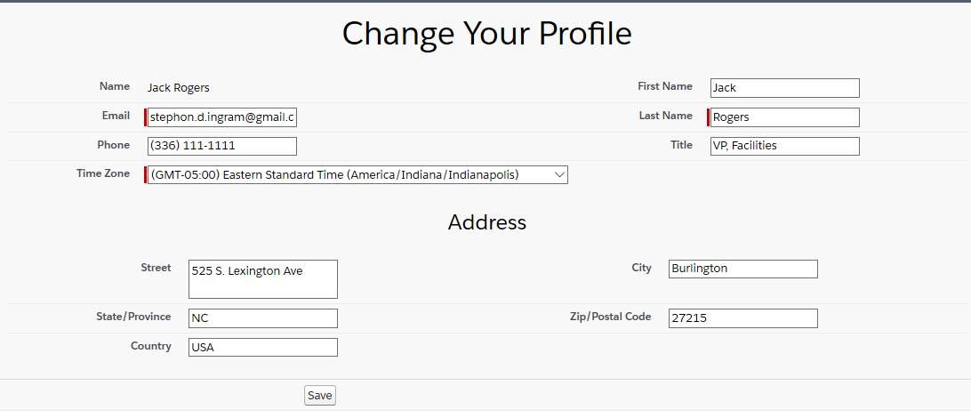
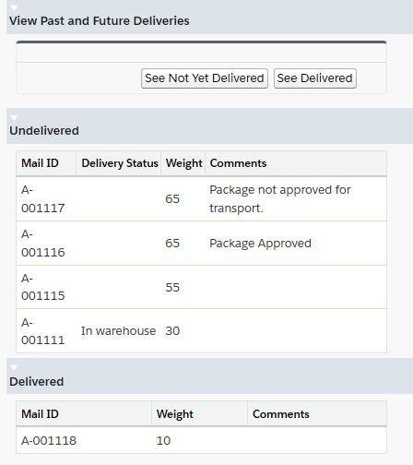
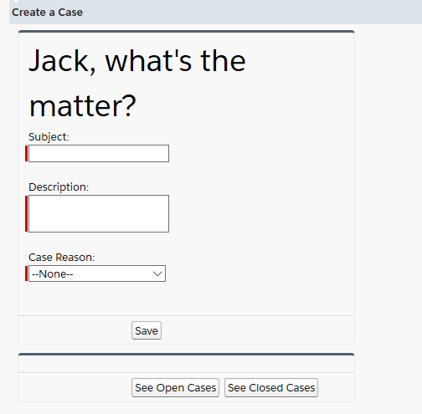
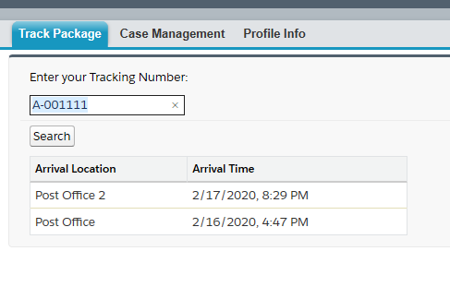
Mail Hub Community!
Edit Profile | Track Cases | Track Shipments | Track Deliveries

Slide 4

Who is Jack Rogers?
Primary Test User
Jack is a customer looking for information about his mail packages. He is a Customer Community User, and is in a private sharing model.

Slide 5

What does Jack Do?
Things to Do
Jack logs in to the community
Jack views packages, future and past
Jack tracks individuals packages
Jack can open or edit a case.
Jack can change his info.

Slide 6
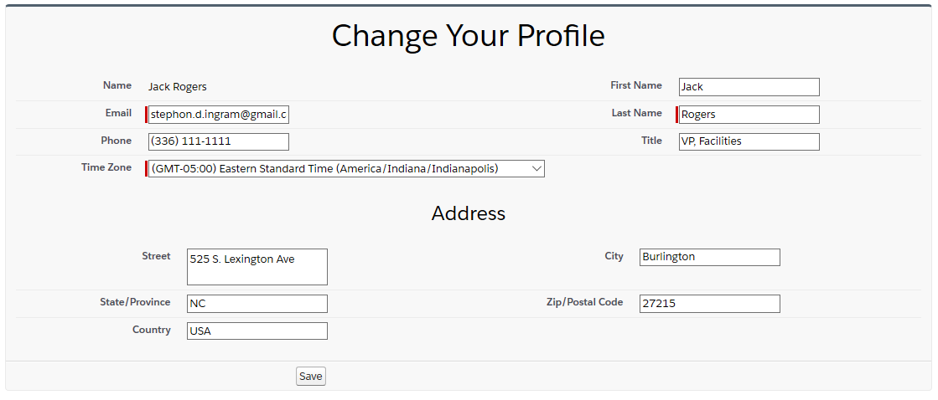
Edit Profile

Slide 7
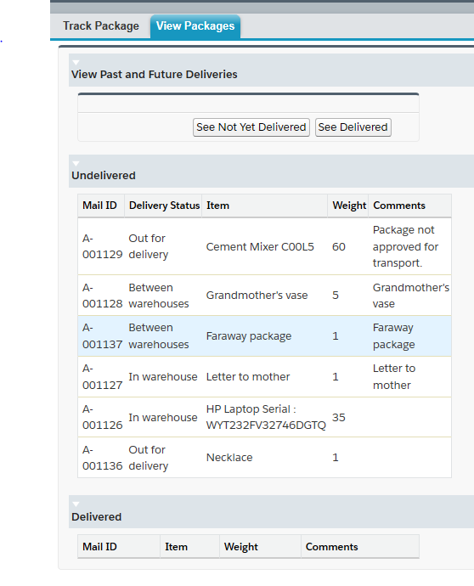
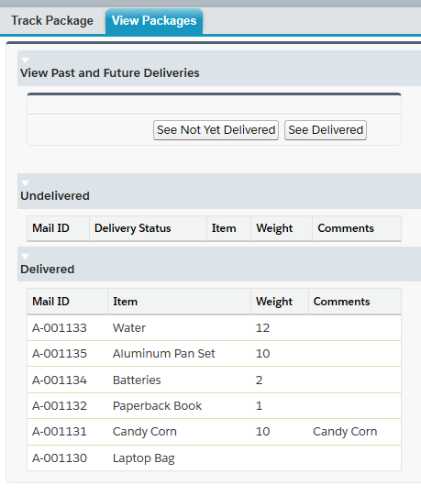
Checking Packages

Slide 8
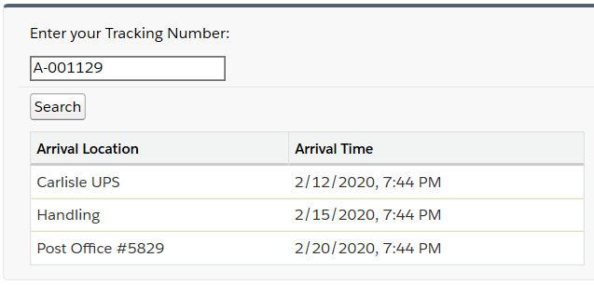
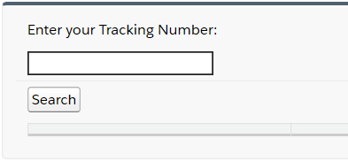
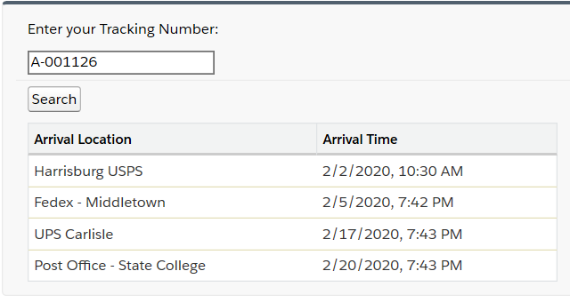
Tracking
Packages

Slide 9
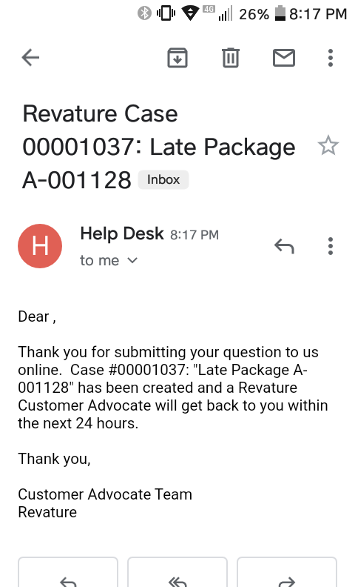
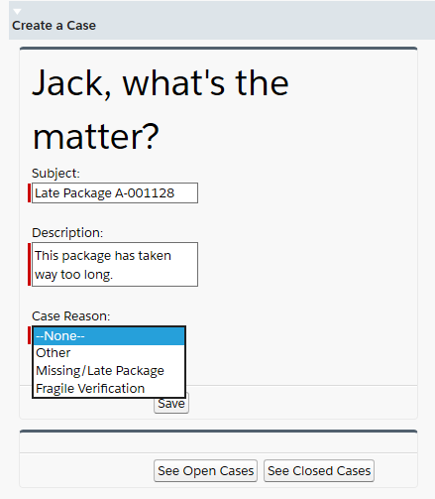
Create Case

Slide 10
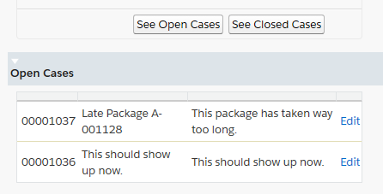
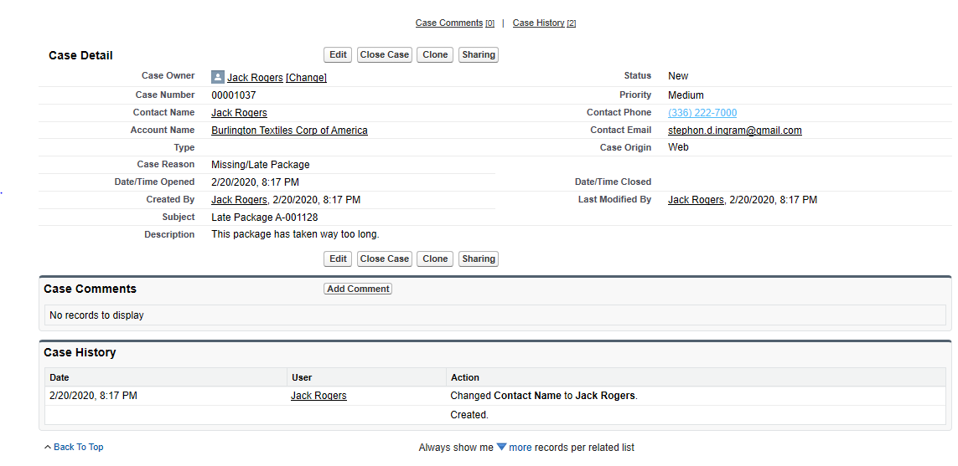
Edit
Case

Slide 11
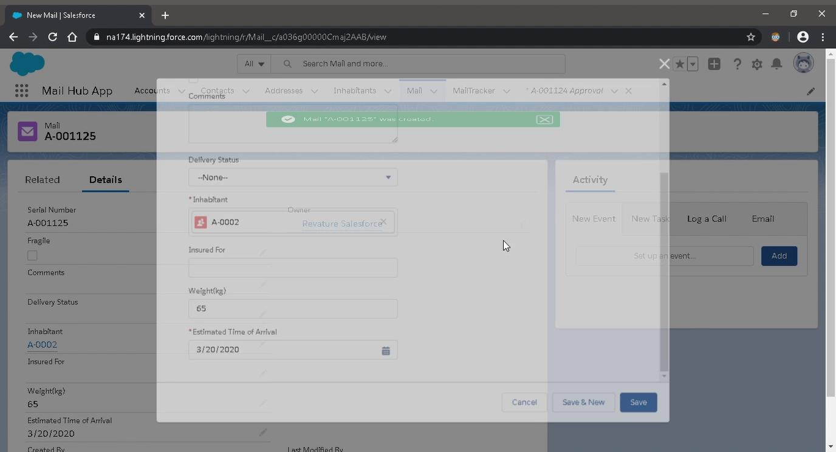
High Weight Items
Process Builder
to
Approval Process

Slide 12
Closing
Recap
Community
Jack Rogers
Jack’s Actions
Process

Slide 13
Thank You!

